Slide 1
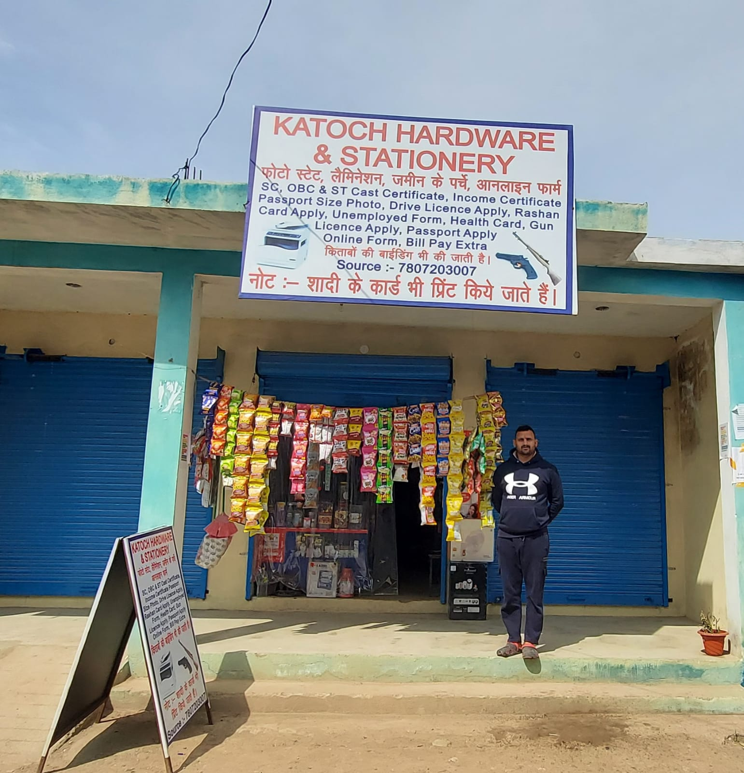
Business Data Management – Capstone Project
Katoch Hardware and stationery, Indpur (Himachal Pradesh)
Shop started in August 2021.
Location – Near Government High School Indpur.
Good Market place nearby.
Near to my house.
Vivek Katoch, a sole owner was convinced to provide data to me
Analysis of various trends are done for a month on weekly basis.
Analysis of data for decision making and growth of Business.
Hardik Sharma
21f1006555@student.onlinedegree.iitm.ac.in

Slide 2
Weekly Sales trend
Week | Sum of Sales
Week_01 | 724
Week_02 | 703
Week_03 | 714
Week_04 | 711
Observations:-
1. This table and chart show that almost the same amount of SKUs are sold across 4 weeks.
2. Although for different weeks sales for different items get hiked and driven but on an average sums of sales remained constant.

Slide 3
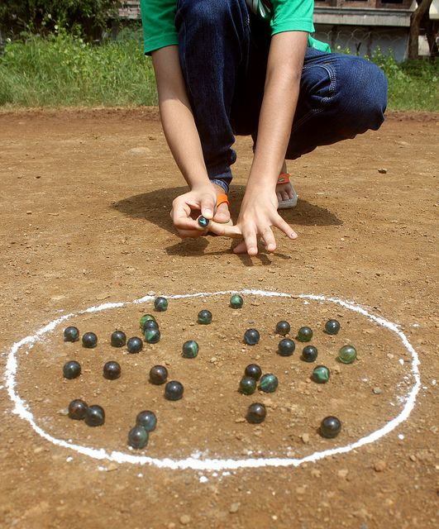
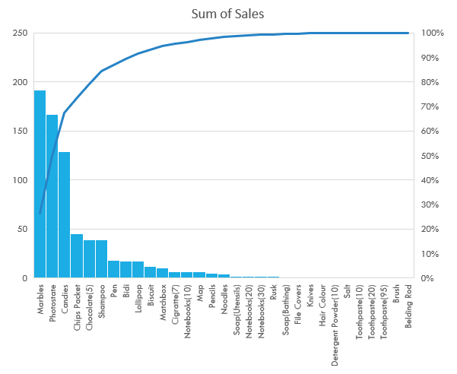
Sales Pareto Analysis
Classification of Stocks
Fast moving items | Slow-moving items | Very Slow or Non-moving items
Playing Marbles | Pen | Soap(Bathing) File Covers
Photostate | Bidi | Knives
Candies | Lollipop | Detergent Powder
Chips Packets | Biscuit | Salt
Chocolate(5) | Matchbox | Toothpaste
Shampoo | Cigarette | Brush
 | Notebooks | Belding Rod
Observation: This curve shows that the sum of sales follow the pareto principle. Since it can be clearly seen top 6 items out of 32(20% of items) contribute to almost 80% of sales.

Slide 4
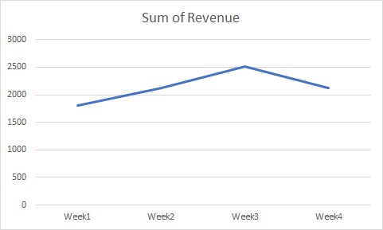
Weekly Revenue Trend
Week | Sum of Revenue
Week_01 | ₹1810
Week_02 | ₹2127
Week_03 | ₹2517
Week_04 | ₹2118
Observations:-
1. This table and chart show a sudden increase in profit from Week1 till Week3 afterward, the revenue declined for week 4 despite having similar Sums of Items sold. Then I analyzed that in week1 sales of playing marble(item constituting very less price of ₹0.25) was highest among all 4 weeks which increased the items sold but had minimal effect on Revenue.
2. The peak in Week3 is due to starting of final exams for students in govt. school which increased sales of pens and pencils(high margin products).

Slide 5
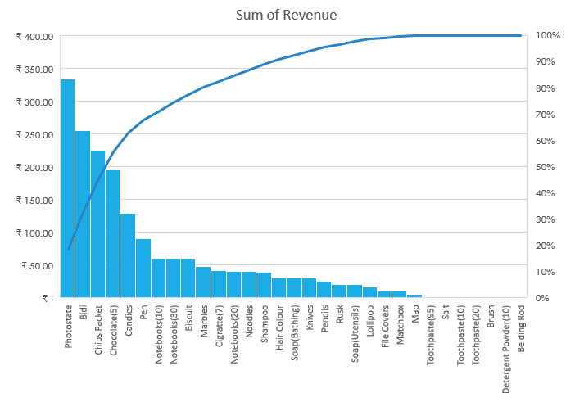
Revenue Pareto Analysis
Week | Revenue(₹) | %Change in Revenue
Week-01 | ₹1,810 | --
Week-02 | ₹ 2127 | 4%
Week-03 | ₹ 2517 | 5%
Week-04 | ₹ 2118 | -5%
Total | ₹ 8572
Observation: This curve looks flat which shows it is not following pareto principle(maybe due to less quantity of data).

Slide 6
Trends of profits
Week | Profit | % of Profit
Week-01 | ₹293 | 19%
Week-02 | ₹380 | 24%
Week-03 | ₹529 | 34%
Week-04 | ₹367 | 23%
Total | ₹1569
Observations:-
1. There’s an increase in profit from Week1 till Week3 and after that till week 4 there is decrease in profit this is because in week 1 more marbles were sold which was a product owner was selling in loss.
2. In Week 2 owner sales of notebooks(higher margin product) increased.

Slide 7
Recommendations to owner
Be punctual and regular in the opening shop, especially before school hours.
To attract school children, initiate petty schemes like giving a toffy to 1st child customer of the day or on purchase of ₹ 50.
Instead of buying non-moving stock try to procure the variety of fast-moving stock for gaining more profits.
Advertise the non-moving stock and online services by display in front of the shop or via social media.
Display and advertise his pricelist as his prices are cheapest in locality e.g. photostat charges etc.

Slide 8
Tips for newcomers in course
1. Start as early as possible(larger the data better are the observations) don’t wait for the deadlines.
2. If you are unable to find a wholesaler proceed the project with a retailer or tea shop or barber shop(comparatively easy to find).
3. Do real work, since copied work could be caught and if not caught it won’t give you satisfaction.
ALL THE BEST FOR UPCOMING TERM!!!
Hardik Sharma
21f1006555@student.onlinedegree.iitm.ac.in

